Slide 1
Michigan Biological Software JavaScript Tutorial
Ali Turfah

Slide 2
DISCLAIMER
JavaScript has nothing to do with Java

Slide 3
Motivation
Want our websites to be responsive
How do you send data to a server?
Don’t want to reload the page every time

Slide 4
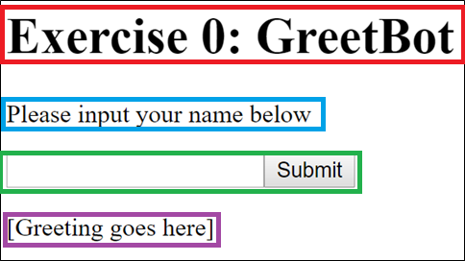
Exercise 0: Overview
<h1>Exercise 0: GreetBot</h1>
<p>Please input your name below</p>
<input id="ex0_in" type="text" />
<button onclick="ex0();">Submit</button><br />
<p><span id="ex0_out">[Greeting goes here]</span></p>
<script>
function ex0() {
name = document.getElementById("ex0_in").value;
if (name.trim() == "") {
alert("Please enter a valid name!");
return
}
document.getElementById("ex0_out").innerHTML = "Hello " + name + "!";
}
</script>

Slide 5
Motivation
Words

Slide 6
Motivation
Words

